Slide 1
Moving Legacy Lotus Notes Applications to HarperDB
Compelling data technology to capitalize on legacy investments.

Slide 2
Value in an unsupported environment
Large volume of valuable data
Organization doesn’t have the desire or capability to support the environment
Organization does not want to license server or clients any longer
Development teams using other technology stacks
Notes:
I have a notes application that contains valuable data but my organization no longer wants to support the environment, or license Notes clients. I have an existing development team but none of them know how to program in Notes nor have the desire to learn.
Using HarperDB I can easily move data out of Notes very quick with full fidelity and capitalize on the skills of the existing non-Notes development team. In this presentation, I'll turn a standard Notes application
into a web-based application while gaining the capability to quickly query data using structured query language with no driver.

Slide 3
Benefits
Unreasonably easy to move Notes data into a new platform (hint: you support native formats and don't change any data!)
Clever Querying using standard Structured Query Language even though the data is not normalized in any way
Existing non-Notes development teams can be instantly productive with your legacy notes data via REST API or Drivers
No dependence on a Notes/Domino server, and no longer need specialized development skills (Domino developers)

Slide 4
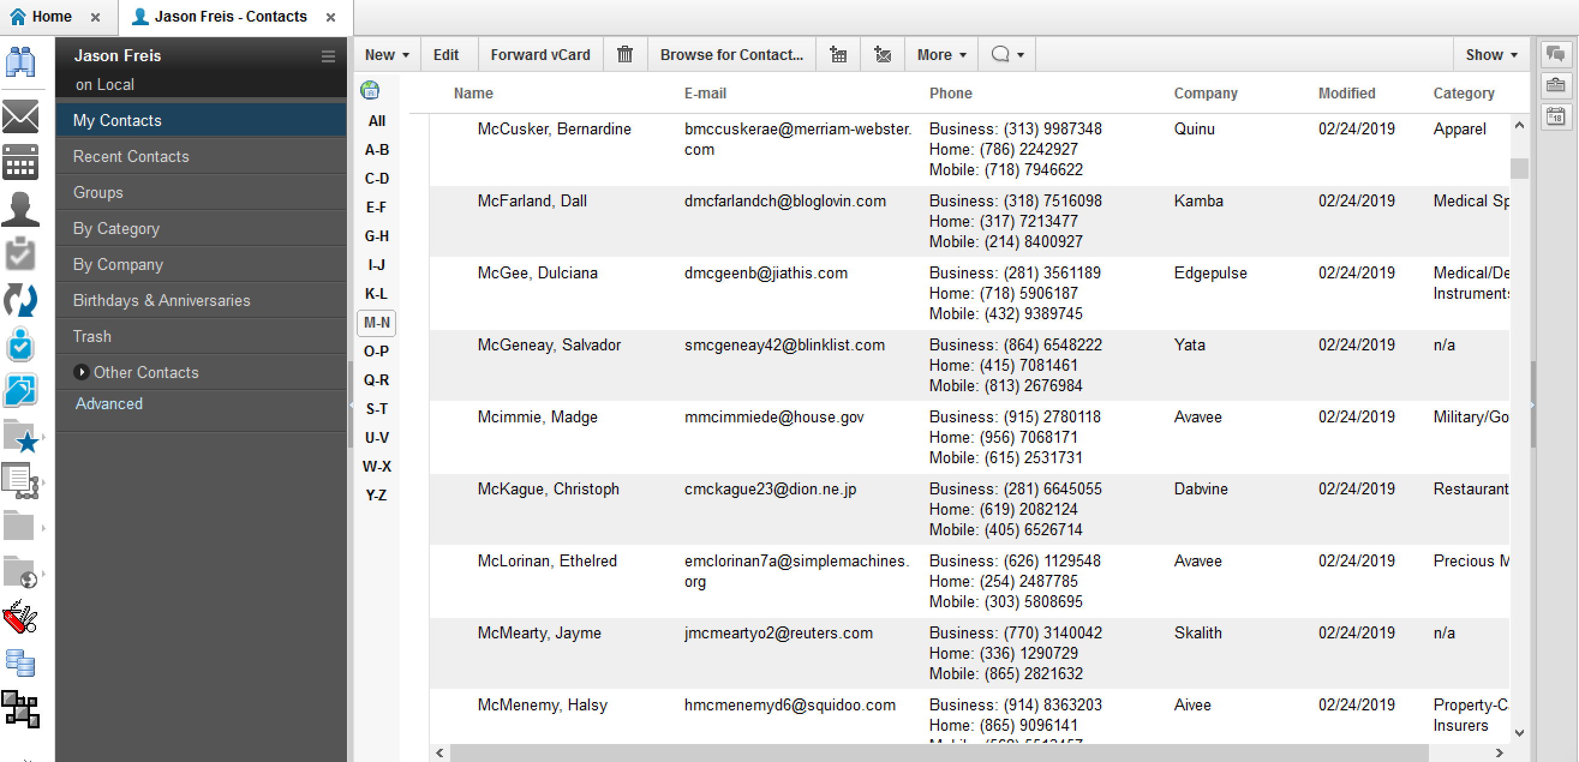
Example Application: names.nsf
Notes:
You can use this on any Notes application, but in this case we’ve selected an application from the vendor… Contacts
Using a simple export agent written in Java that runs in the Notes application, I can export all Notes documents into json objects. I'll import this data into HarperDB with no data manipulation and create a simple website to query this data. During this demo, you'll see the HarperDB cloud interface, and the HarperDB rest api's available to query and view data.

Slide 5
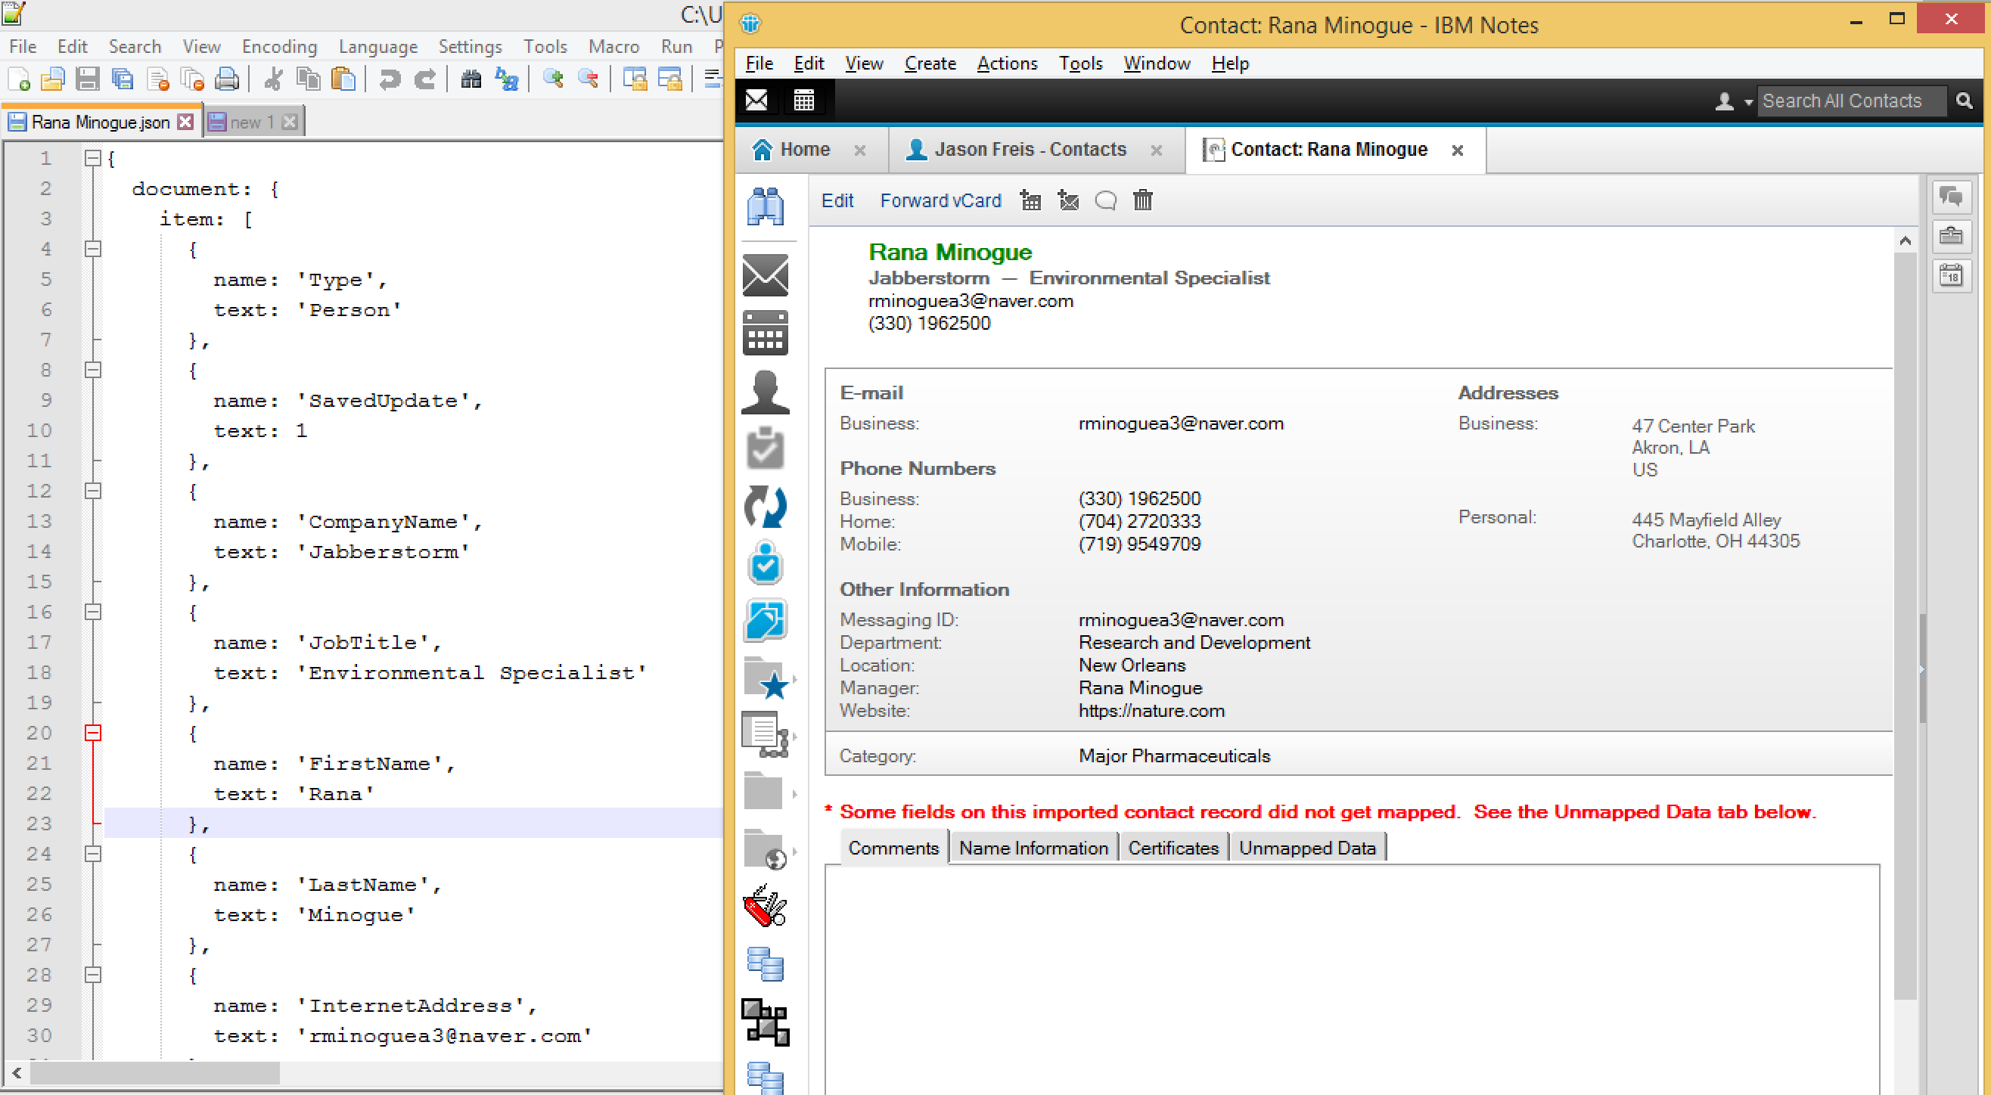
Notes Application Document & JSON
Notes:
If you've never seen a Notes document represented in json before, it looks like this. The document contains all the Notes Items (storing the data) and document specific data (like form name, unid, last modified date, etc.). Let's take a look, Here is a notes document in the contacts application and the same document represented in JSON.
There is a Java agent that will export all the Notes documents in the application to a .csv file of JSON objects that can be imported with full fidelity into HarperDB.
Keep in mind, this JSON format is what the Notes application provides, no changes have been made. You’ll find the java code in the Git repository. Now let’s create the HarperDB instance and import it

Slide 6
Create the HarperDB Instance
Go to https://studio.harperdb.io
Create an account
Create a new HarperDB Cloud Instance
Instance Name
Username credentials

Slide 7
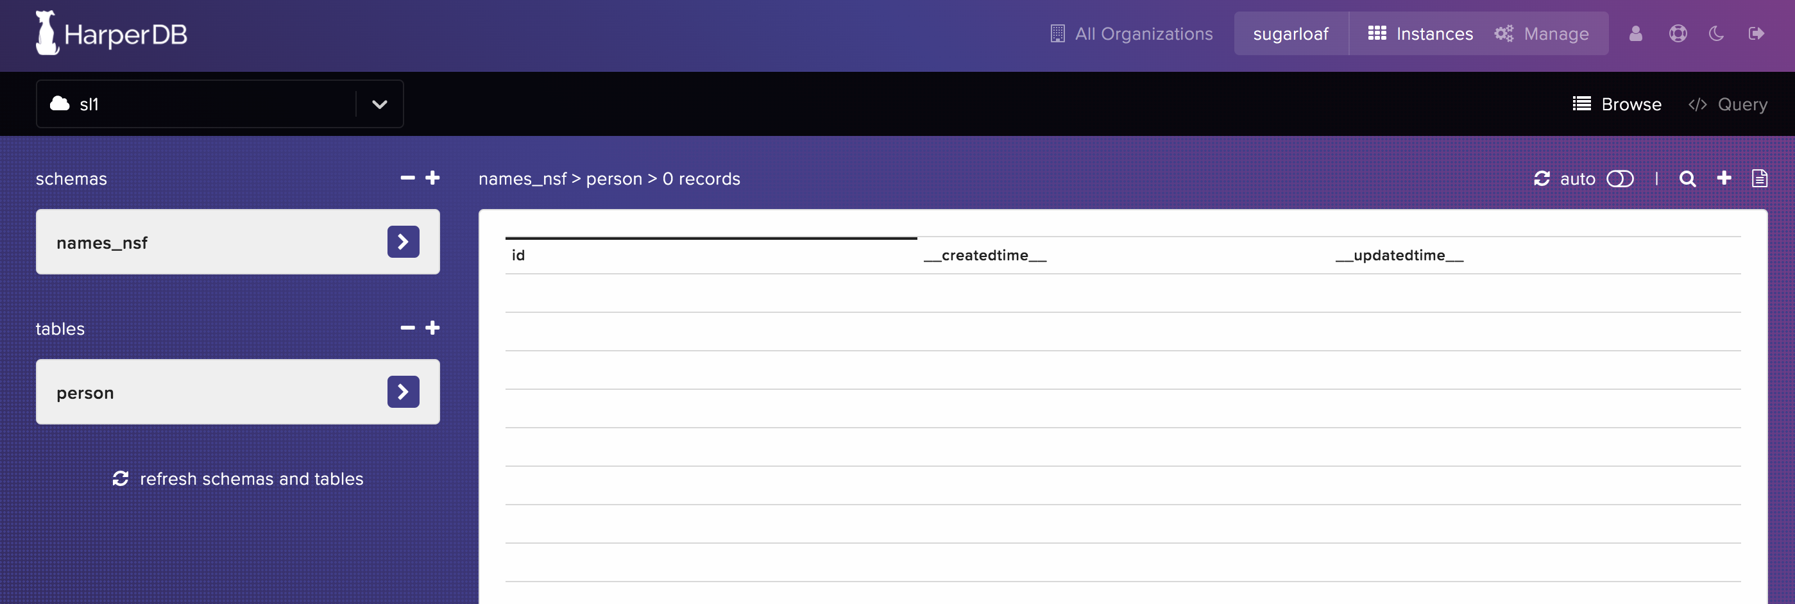
Schema, Table, and Hash
Notes:
For this example (and the website code to work) create the schema with “names_nsf”, create the table as “person” and the hash attribute of the table as “id”
In the right corner above the table columns click the “Bulk upload CSV to person” button

Slide 8
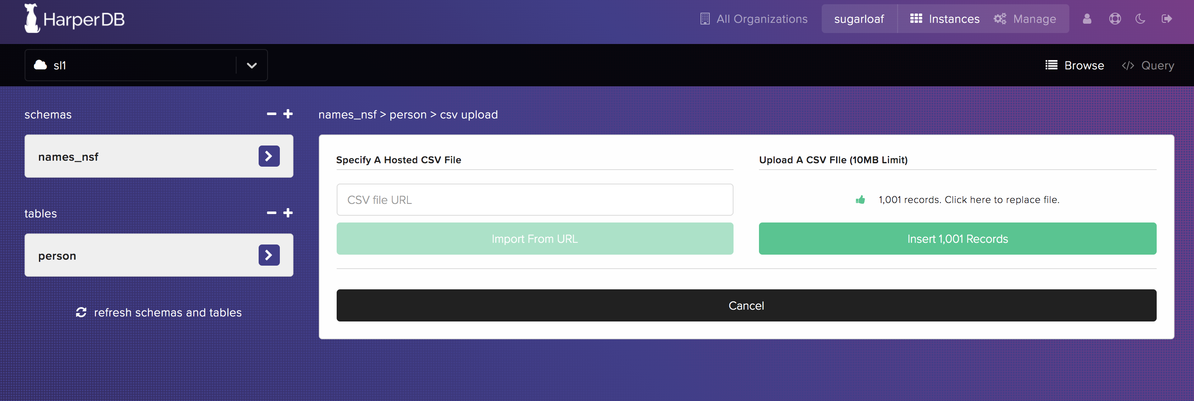
Bulk Upload Notes Data into HarperDB
Notes:
Select the output file of the java agent that exported the data (alldocs.csv) and click the insert 1001 records button. And the data will be imported.

Slide 9
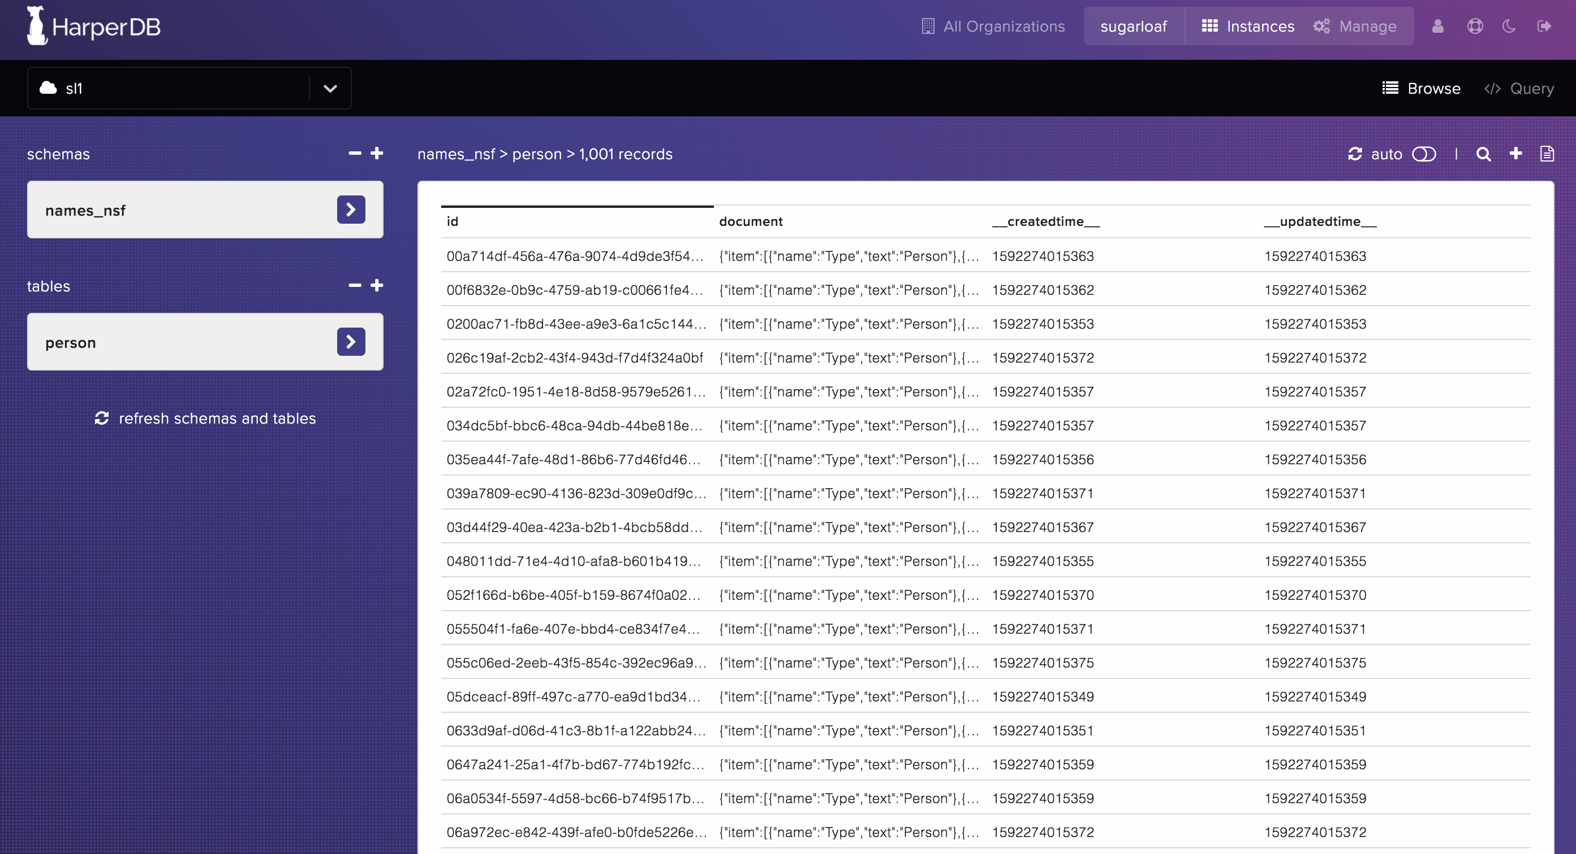
Notes Data as JSON objects in HarperDB
Notes:
The data will be imported, and will appear like this. Notice.. Upon import, HarperDB creates 3 columns an ID, a created time and an updated time. The “document” column is a json object representing a Notes document from the application. Select a row to display the JSON object.

Slide 10
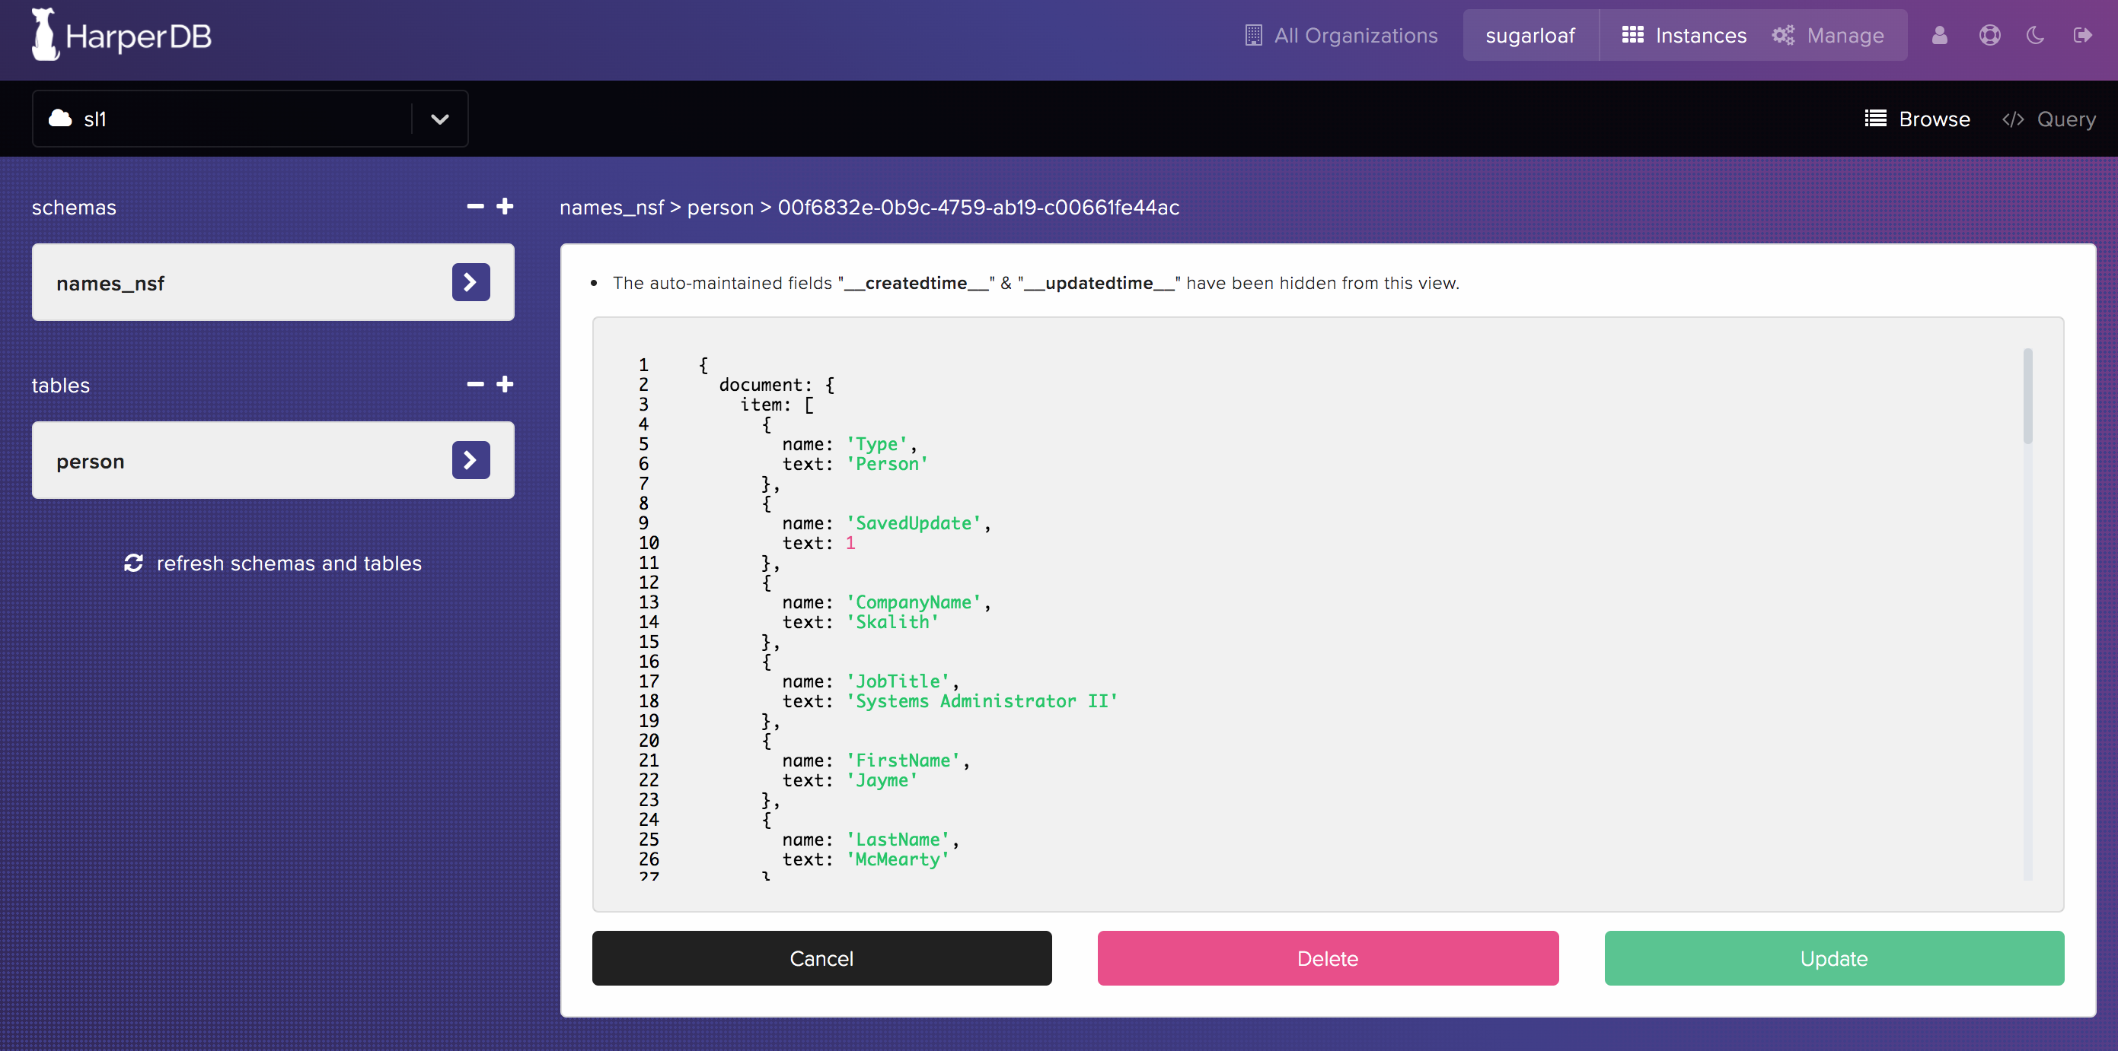
JSON Object in a Row
Notes:
Notice that this is simply a Notes document as JSON.

Slide 11
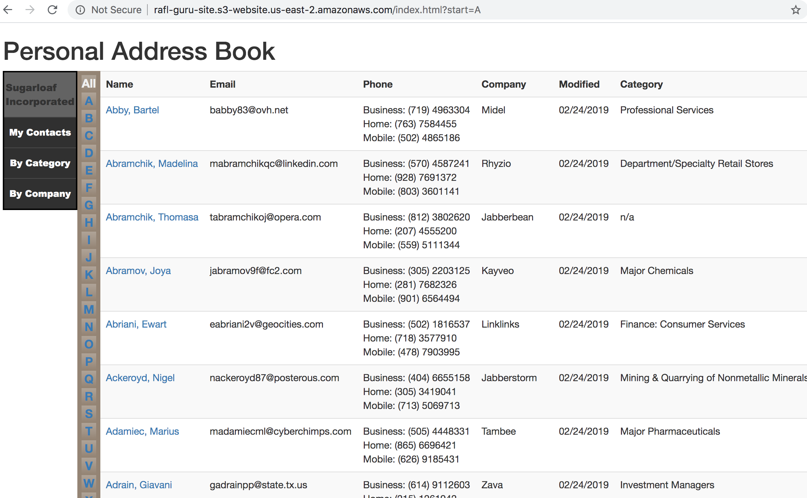
Simple Web Application with HarperDB as the backend
Notes:
Recap: We’ve exported all data out of a Notes application and imported into HarperDB with NO ETL.
The data is stored as JSON Objects
We’ve built no indexes, we’ve not normalized the data, we’ve done nothing except export it from notes and import it to HarperDB
The 3 html files (index.html, person.html, and editperson.html) use HarperDB’s native REST endpoints to retrieve and modify data. This is SQL!
Because HarperDB incorporated jsonata into its query engine, we have the capability to run SQL on json objects stored in the database. This application uses ONLY NOTES DATA selected and updated by SQL. We’re not using the HarperDB hash, we’re using the Notes UNID.

Slide 12
Test Application
http://rafl-guru-site.s3-website.us-east-2.amazonaws.com/

Slide 13
Query used on index.html
Notes:
Notice the use of the jsonata SEARCH_JSON structure. This allows us to query directly into the Notes document json object stored in HarperDB. With a few differences in format, we’ve got Structured Query Language gathering our Notes data from json objects stored in HarperDB.
The index.html page also checks for a url query string to determine the first letter of the last name. Keep in mind though, the web application platform or functionality doesn’t matter. With the HarperDB query engine, your development teams can get access to Notes data in native json format using traditional SQL.

Slide 14
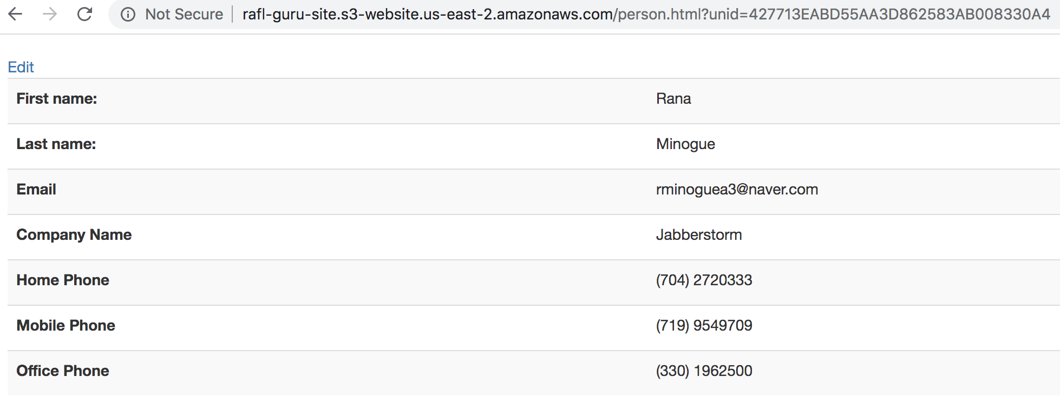
Viewing Details
Notes:
The first query used the jsonata attributes of the HarperDB query engine to pull specific Notes items from the JSON object. In the person html, we simply bring back the entire object by querying the database with the Notes UNID of the document. We then parse the object on the page.

Slide 15
Query for person.html
Notes:
We’re not using the HarperDB id, but rather the UNID from the Notes document.

Slide 16
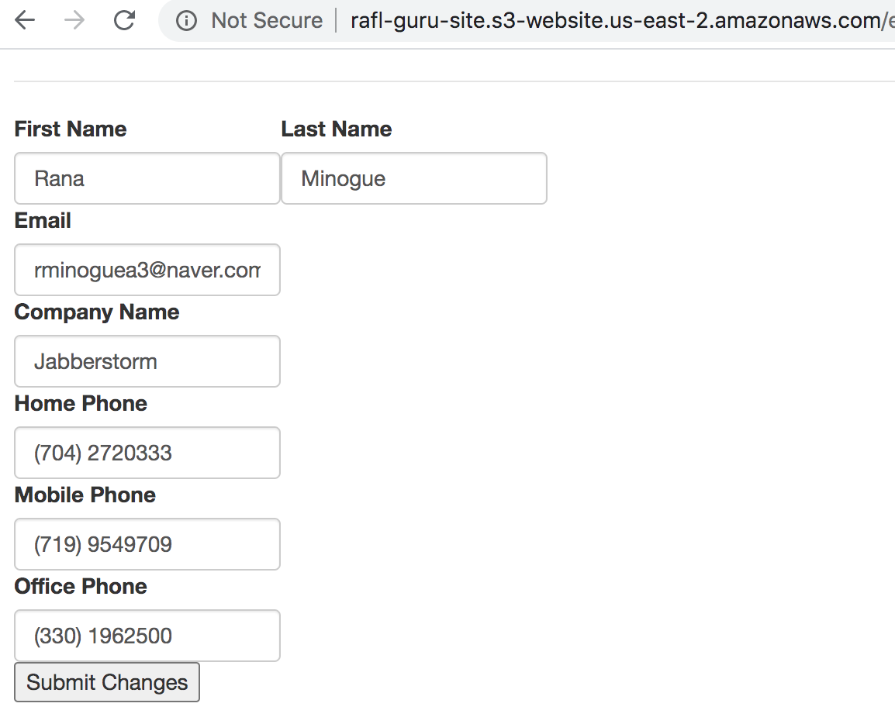
Updating the JSON Object
Notes:
Using the same query as the person.html, we’re pulling down the whole json object. Allowing the user to edit values. The update query uses some more of the jsonata functionality to push values right back into the JSON object stored in the HarperDB

Slide 17
Query for editperson.html
Notes:
This single query with the jsonata format allows the update of values straight into the json object. The reference to the “apiEndpointQueryString” is simply the UNID querystring in the URL of the page.
This website, the java export agent and setup instructions are in the Github repository

Slide 18
Additional Benefits of HarperDB
Clustering & Replication
A secure REST API - every call is authenticated (similar to the Notes Remote Procedure Call)
Cloud Native
An unbelievably responsive product development team committed to your success
Excellent pricing

